Slide 1
MAGNETOMETER-LESS STATE-ESTIMATION OF A MOBILE ROBOT USING CASCADED KALMAN FILTERS
By Tommy Le
Advisor: Dr. Ji-Chul Ryu 10/13/2023

Slide 2
Outline
Introduction
Previous Work
Objective
Framework
Preprocessing methods
Mobile Robot Extended Kalman Filter
IMU Extended Kalman Filter
Simulation Results
Remaining Work
Notes:
- introduction of localization and robotics
- prev relevant work
- objective
- framework and working details of proposed algorithm
- Afterwards, simulation results
- then discuss remaining work of thesis

Slide 3
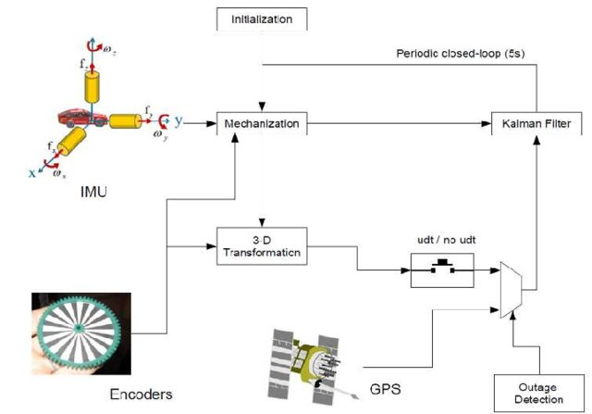
Background
Mobile robot localization
Outdoor
GPS
Indoor
Magnetometer, UWB
Both
Encoders, vision systems
Common Outdoor Localization Framework [1]
[1] E. North, J. Georgy, M. Tarbouchi, U. Iqbal and A. Noureldin, “Enhanced Mobile Robot Outdoor Localization Using INS/GPS Integration,” IEEE Explore, Jan. 2010.
Notes:
- State estimation and localization is one of the fundamental blocks in the dev of AMRs
- effective navigation needs robust localization algo
- most localization applications use an IMU with external reference sensor for global measurements and compensate for the IMUs errors
- Outdoor is GPS
- Indoor, GPS doesn’t work so implementations turn to magnetometers
- This thesis will focus on indoor localization and the shortcomings of using magnetometers for sensor fusion

Slide 4
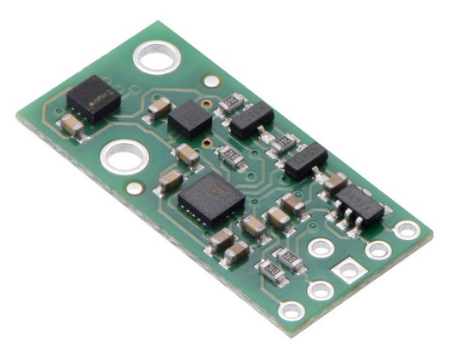
Background
Inertial Measurement Units (IMUs)
Tri-axial accelerometer, gyroscope
Sometimes magnetometer
Used for pose information
Errors
Accelerometer has high frequency noise
Gyroscope suffers from drift
Pololu 10 DOF IMU [2]
[2] “Pololu - AltIMU-10 v5 Gyro, Accelerometer, Compass, and Altimeter (LSM6DS33, LIS3MDL, and LPS25H Carrier),” www.pololu.com. https://www.pololu.com/product/2739 (accessed Oct. 09, 2023).
‌
Notes:
- like to provide further background information on IMUs
- has tri-axial accel and gyro and is commonly paired with a mag
- although it is very common, it has its own errors
- accel has high frequency noise, gyro drifts, and magnetometer is susceptible to hard and soft iron distortion

Slide 5
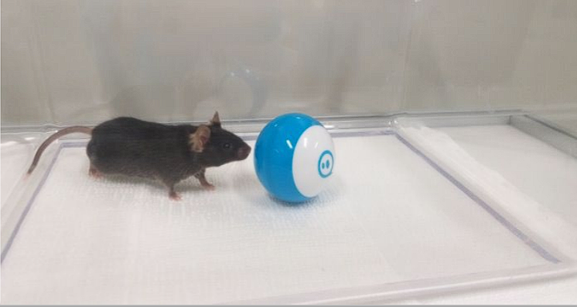
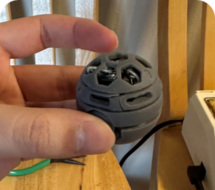
Motivation
Desire small spherical robot for indoor navigation
Experiments with common lab animals
Magnetometer suffered due to placement of motors
Other sensors do not fit size requirement
Notes:
- Recently lab has been conducting research in development and control of miniature spherical robots
- one project is application in psychology for experiments with common lab animals
- for a smaller size and better control a custom robot was designed
- One challenge was fitting all hardware inside while remaining undersize
- Eventually able to fit everything but the magnetometer suffered in performance due to proximity to electronics and motors
- solutions included adding different sensor into shell which increases size
- Another would be using external sensor like a vision system which would require extra setup
- led to idea of dev our own estimation algo

Slide 6
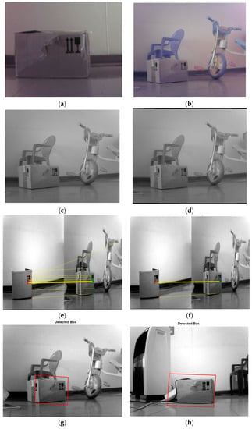
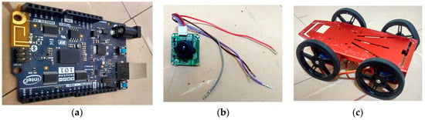
Previous Work
Pose Estimation of a Mobile Robot Based on Fusion of IMU Data and Vision Data Using an Extended Kalman Filter [3]
Object recognition and feature matching
State transition matrices are IMU and vision
4 wheeled mobile robot
[3] M. Alatise and G. Hancke, “Pose Estimation of a Mobile Robot Based on Fusion of IMU Data and Vision Data Using an Extended Kalman Filter,” Sensors, vol. 17, no. 10, p. 2164, Sep. 2017, doi: https://doi.org/10.3390/s17102164.
‌
Notes:
The area of localization for mobile robots is one that has been around for a long time. One project involves pose estimation for a robot using IMU and vision data. Here they use object recognition and feature matching to provide global pose information and fuse it with the IMU data to provide state estimation. For their EKF, the state transition matrices are the IMU and vision system and do not take into account the kinematic constraints of the mobile robot.

Slide 7
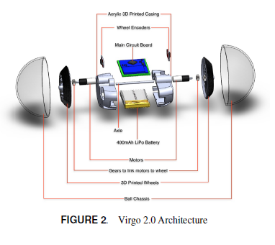
Previous Work
Localization and Trajectory Tracking of an Autonomous Spherical Rolling Robot Using IMU and Odometry [4]
Encoders
Requires wheel odometry
Magnetometer
Larger robot to isolate magnetic distortion
Dead reckoning for localization
[4] V. Ajay, A. Suherlan, G. Soh, S. Foong, K. Wood and K. Otto, “Localization and trajectory Tracking of an Autonomous Spherical Rolling Robot using IMU and Odometry ,” ASME, Aug. 2015.‌
Notes:
This work discusses the design and tracking of a spherical robot using IMUs and wheel odometry. For sensors, magnetometers, wheel encoders, and the 6 DOF IMU were used. The orientation estimation was handle through a complementary filter between the IMU and magnetometer and position data was estimated using dead reckoning by transforming the encoder data given the orientation data calculated using the complementary filter.

Slide 8
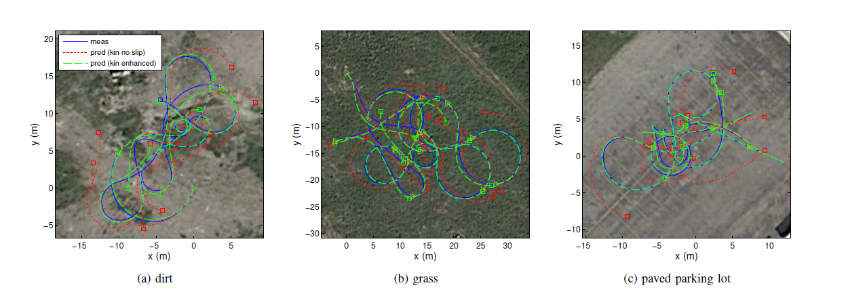
Previous Work
Enhanced 3D Kinematic Modeling of Wheeled Mobile Robots [5]
No real-time implementation
Able to provide robust estimation with just a kinematic model
[5] A. Kelly and N. Seegmiller, “Recursive kinematic propagation for wheeled mobile robots,” The International Journal of Robotics Research, vol. 34, no. 3, pp. 288–313, Jan. 2015, doi: https://doi.org/10.1177/0278364914551773.
Notes:
Recursive velocity kinematics
Wheel ground contact constraints
Body-level slip prediction
Liftoff prediction
Parameter calibration

Slide 9
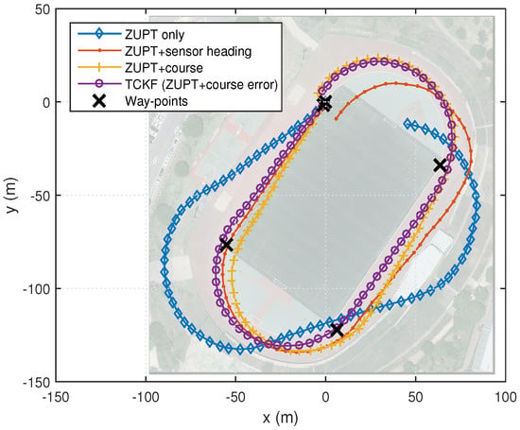
Previous Work
Enhanced Pedestrian Navigation Based on Course Angle Error Estimation Using Cascaded Kalman Filters [6]
IMU to estimate pedestrian pose
INS-PDR-EKF
Magnetometer course correction
Cascaded KF framework
[6] J. Song and C. Park, “Enhanced Pedestrian Navigation Based on Course Angle Error Estimation Using Cascaded Kalman Filters,” Sensors, vol. 18, no. 4, p. 1281, Apr. 2018, doi: https://doi.org/10.3390/s18041281.
Notes:
- Main reference
- Through preprocessing and cascaded KF framework were able to accurately estimate position and orientation even in presence of magnetic disturbance

Slide 10
Objectives
Develop a robust magnetometer-less state estimation algorithm using only IMU data
Design the algorithm so it can incorporate additional sensor data to improve estimation
Notes:
- found that improvements in the field of localization and state-estimation can be made in the areas of magnetometer-less estimation
- Provide examples of sensor data (during presentation)

Slide 11
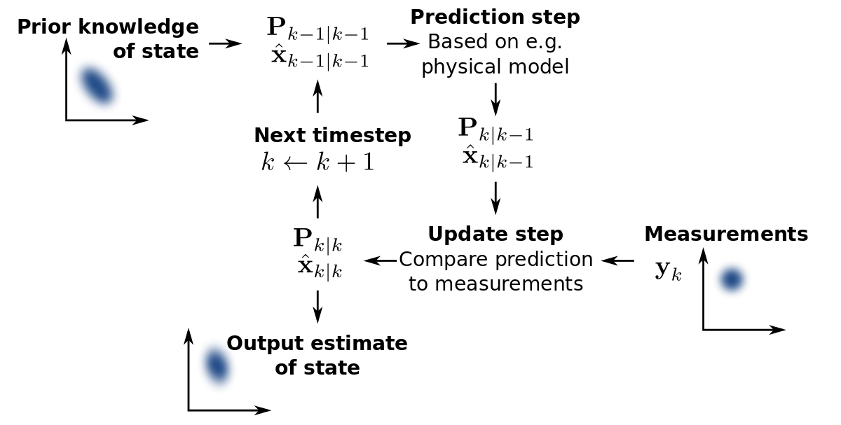
Kalman Filter Review
Kalman Filter
Designed for linear systems
Follows predict and update model
Applications
Pose estimation
Economics
Weather forecasting
Kalman Filter Flow Chart [7]
[7] W. Franklin, “Kalman Filter Explained Simply,” The Kalman Filter, Dec. 31, 2020. https://thekalmanfilter.com/kalman-filter-explained-simply/
Notes:
- provide refresher into algorithm
- optimal estimator for linear systems
- follows predict and update model where it will use a series of noisy measurements observed in time and produce estimates of unknown variables by keeping track of the estimated states of the system and uncertainty of those states
- examples

Slide 12
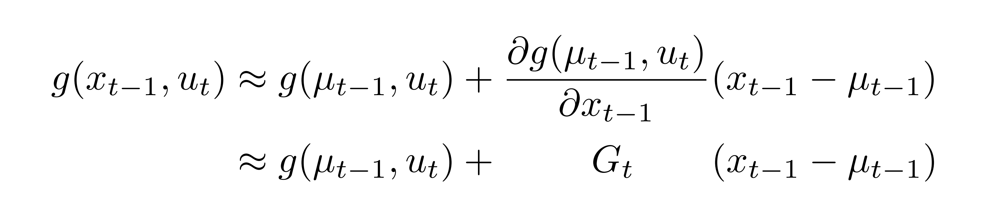
Kalman Filter Review
Extended Kalman Filter
Extension for nonlinear systems
Linearizes using Jacobians
Linearization using the Jacobian and Taylor Expansion [8]
[8] K. Kitani, “Extended Kalman Filter,” Computer Vision CMU. https://www.cs.cmu.edu/~16385/s17/Slides/16.4_Extended_Kalman_Filter.pdf/
Notes:
- most systems are not linear in real world
- EKF is extension for nonlinear systems
- linearizes using Jacobian and Taylor expansions

Slide 13
Kalman Filter Review
Cascaded Kalman Filter
Alternative to augmenting states
Small computation amount
high data rate
strong real-time performance
Pros | Cons
Simpler | Sequential Processing
Modular | Complexity tuning
Computationally cheaper
[9] Y. Li, C. Liang, M. Lu, X. Hu, and Y. Wang, “Cascaded Kalman filter for target tracking in automotive radar,” The Journal of Engineering, vol. 2019, no. 19, pp. 6264–6267, Oct. 2019, doi: https://doi.org/10.1049/joe.2019.0159.
Notes:
- one has the option to augment states from one subsystem to another or cascade Kalman Filters
- summarized as having a lower computational requirement and in turn a higher data rate and stronger real-time performance due to the simplicity of cascaded filters rather than large, augmented states
- Verbally explain why we think cascaded kf is best for us

Slide 14
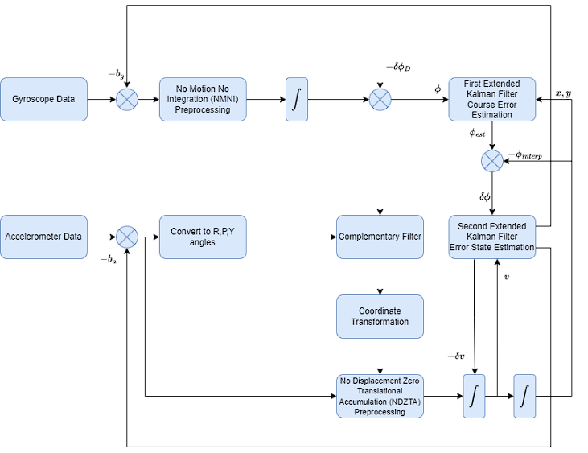
Overall Framework
Notes:
The overall flow of the algorithm is as follows: first the sensor data has its bias removed using the bias estimates from the 2nd EKF and then is converted into pose data. The pose data then has its error corrected through the estimates in the 2nd EKF and is passed to the first EKF which uses the mobile robots kinematic model and compensated measurements to provide an optimal estimation of the mobile robot’s states.

Slide 15
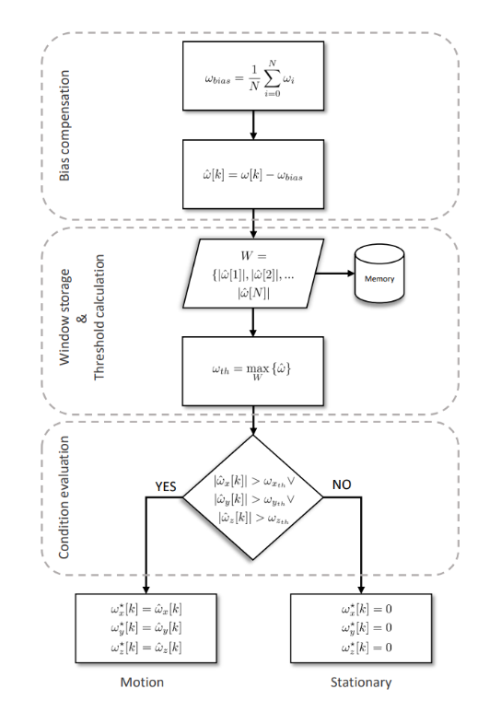
Preprocessing: NMNI
No Motion No Integration
Filters gyroscope data
Bias compensation
Store and update threshold
Check for motion
NMNI Flow chart [10]
[10] M. L. Hoang, A. Pietrosanto, S. D. Iancono, and V. Paciello, “Pre-Processing Technique for Compass-less Madgwick in Heading Estimation for Industry 4.0,” ieeexplore.ieee.org, Jun. 30, 2020.

Slide 16
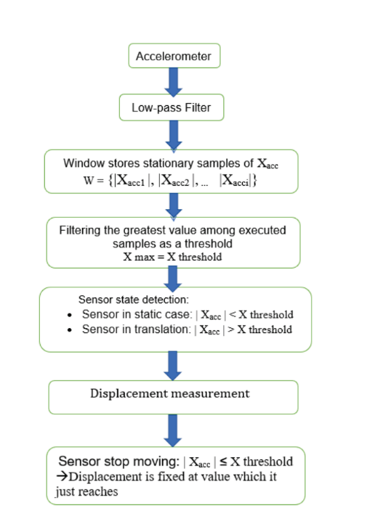
Preprocessing: NDZTA
No Displacement Zero Translational Accumulation
Filters accelerometer data
Low-pass Filter
Store and update threshold
Check for motion
NDZTA Flow Chart [11]
[11] M. L. Hoang, M. Carratu, M. A. Ugwiri, V. Paciello, and A. Pietrosanto, “A New Technique for Optimization of Linear Displacement Measurement based on MEMS Accelerometer,” ieeexplore.ieee.org, Nov. 30, 2020.

Slide 17
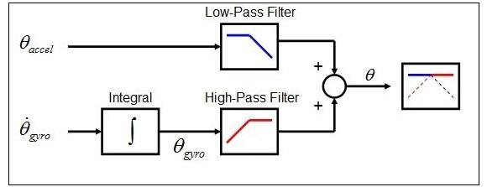
Pre-processing: Complementary Filter
Sensor fusion algorithm for orientation estimation
Complementary Filter Diagram [12]
[12] M. Shah, S. Bhargava, and S. B. K. Mr, “ Mission Planning and Waypoint Navigation of a Micro Quad Copter by Selectable GPS Co-Ordinates,” ResearchGate.
Notes:
- complementary filter is a quick and effective sensor fusion method for blending accelerometer and gyroscope data
- As recap an accelerometer does not accumulate any measurement bias like a gyroscope does but is noisy and a gyroscope provides accurate estimation over short periods of time but drifts over time
- We desire the short-term accuracy of the gyro and long term stability of the accelerometer

Slide 18
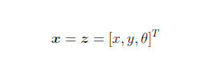
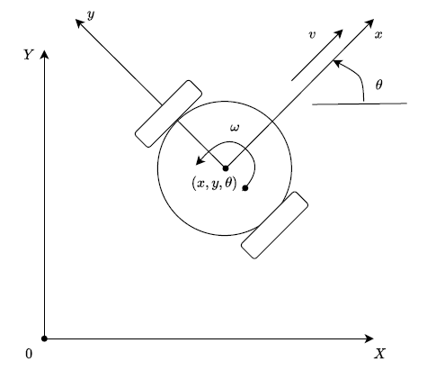
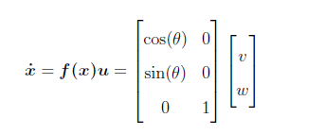
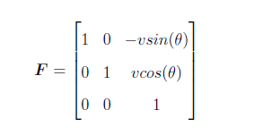
1st Kalman Filter (Mobile Robot): Process Model
Unicycle Model Mobile Robot
States and Measurements
X, Y, and heading
Unicycle Model Mobile Robot Diagram
Notes:
- first Kalman Filter in our algorithm is the course error correction block which uses the Unicycle model mobile robot as its process model
-

Slide 19
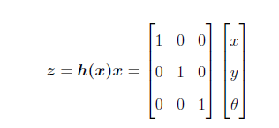
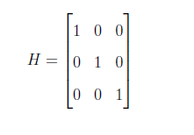
1st Kalman Filter (Mobile Robot): Measurement Model
Measurements are transformed externally

Slide 20
Overall Framework

Slide 21
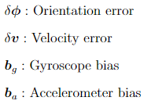
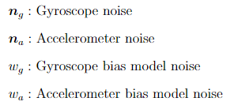
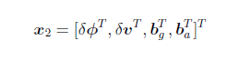
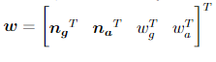
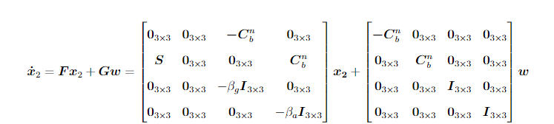
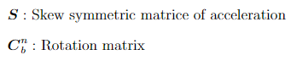
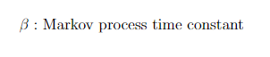
2nd Kalman Filter (IMU): Process Model
Notes:
- This process model is adopted from the popular pedestrian deadreckoning ekf
- The second Kalman Filter is the error state estimator which has orientation and velocity error as well as the gyroscope and accelerometer bias as its states
- input process noise vector w includes ita g and ita alpha representing white gaussian noise vectors for the gyroscopes and accelerometer as well as wg and wa which are the white gaussian noise processes for the sensor bias models
- change in orientation error is described by the summation of the transformed gyro bias and gyro noise
- change in velocity error is represented as S, the skew symmetric matrix of acceleration representing vector cross products, multiplied by the orientation error, summed with the transformed accelerometer bias and noise
- the biases of the accelerometer and gyro which are modeled after the first order Gauss-Markov model where beta is the Markov process time constants that model our biases, and the omegas are the noise in our bias models

Slide 22
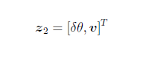
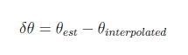
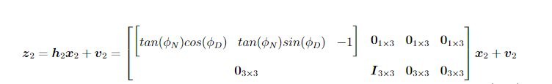
2nd Kalman Filter (IMU): Measurement Model
Measurements
Heading error
Velocity

Slide 23
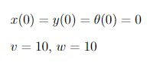
Simulation Results
Ground Truth
Generated from unicycle model kinematics
Testing with circular motion
Time: 0 - 4 sec with 20 ms refresh rate
Measurements generated from ground truth
Drift modeled

Slide 24
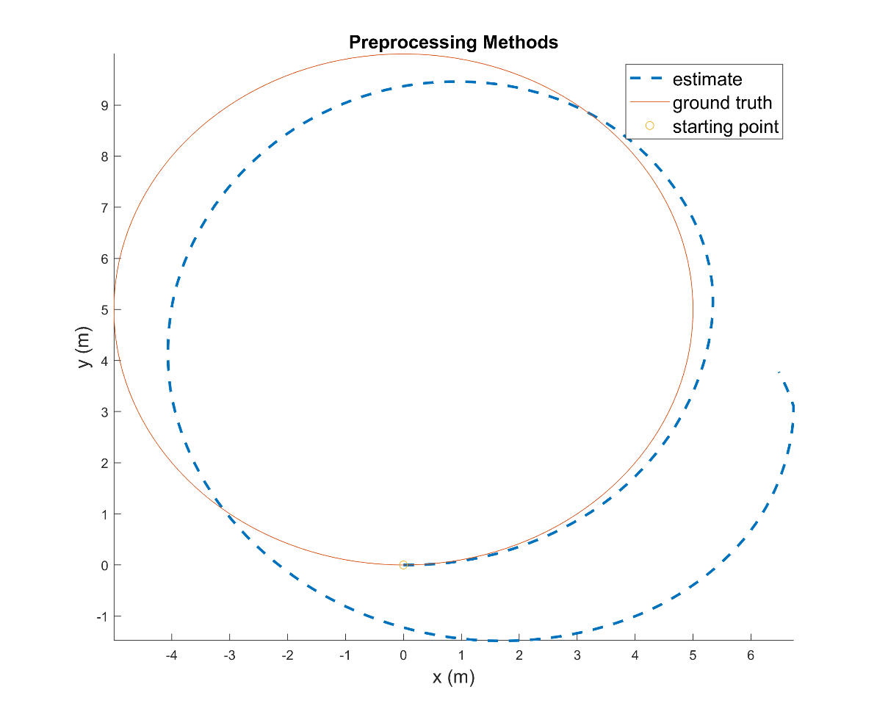
Simulation Results
Preprocessing methods only
Notes:
- To illustrate the improvements in estimation using our proposed algorithm, I will be presenting the trajectory estimation in stages
- estimation using only the preprocessing methods and trapezoidal integration

Slide 25
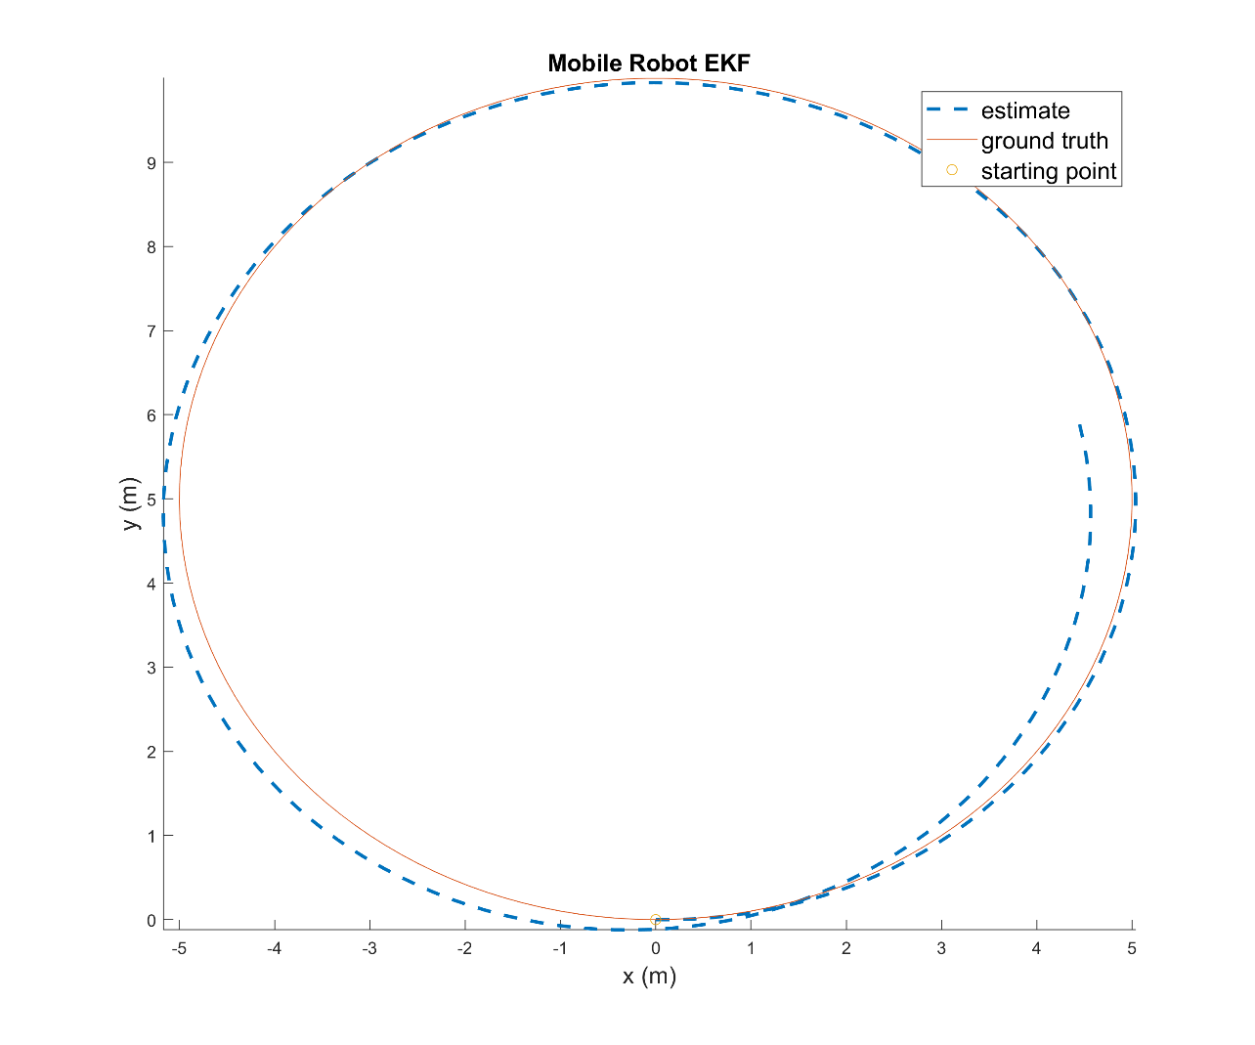
Simulation Results
EKF without error compensation
Notes:
- The next plot shows the 1st EKFs estimate with the unicycle model mobile robot process model

Slide 26
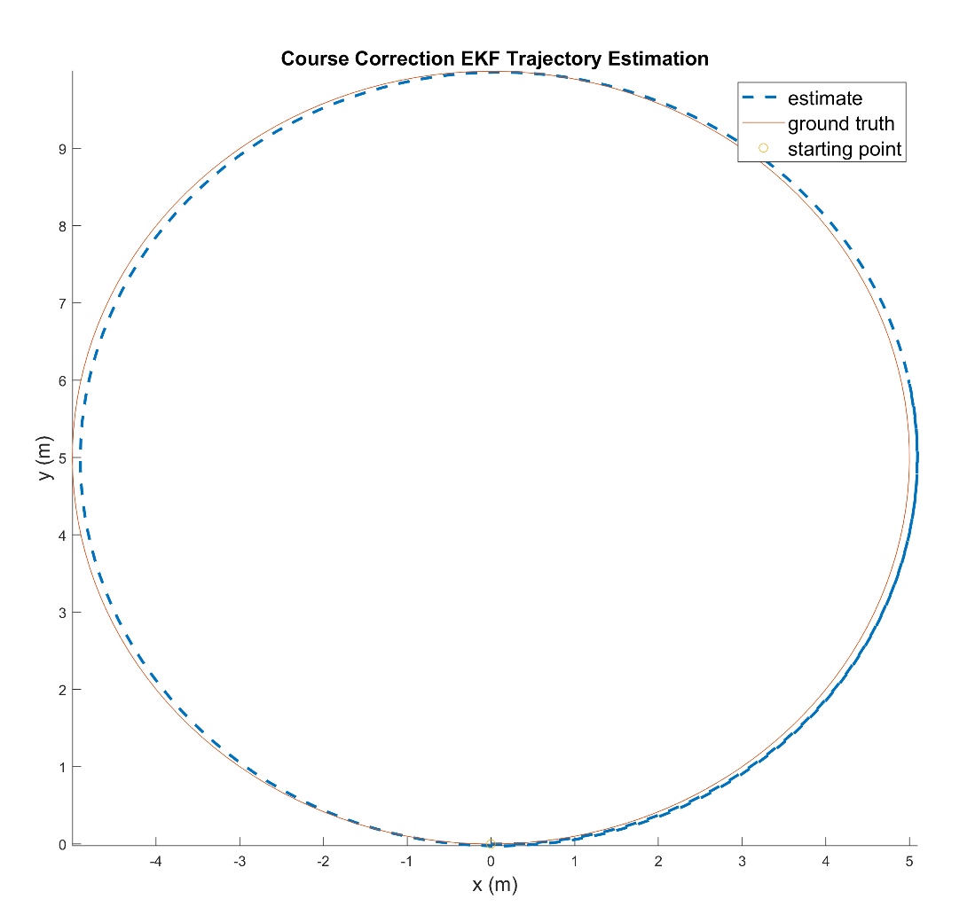
Simulation Results
Fully compensated trajectory estimation
Notes:
fully compensated trajectory estimation from the cascaded KF framework. The estimation is still slightly off and gives about +/- 15 cm accuracy in position however it can be seen that this algorithm provides a more accurate estimation than the previously mentioned while not requiring an additional sensor to provide additional information

Slide 27
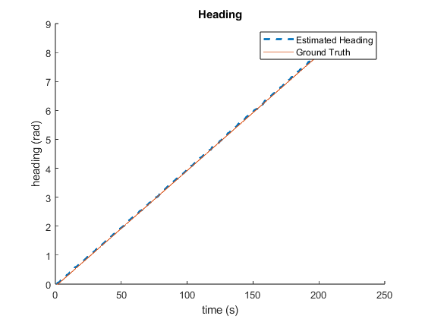
Simulation Results
Estimated heading
Notes:
The remaining slides on the simulation results show how the states themselves compare to the ground truth generated by our kinematic model. The estimated heading is closely tracking the ground truth with a little noise in the estimate. This proves that our filter is an optimal estimator and is able to accurately track simple states

Slide 28
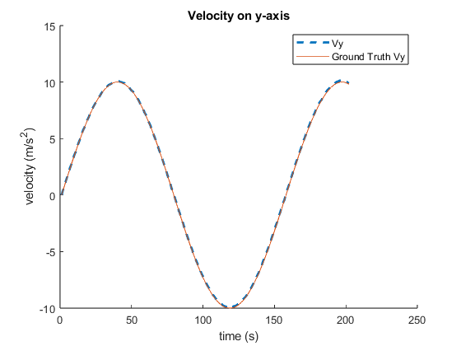
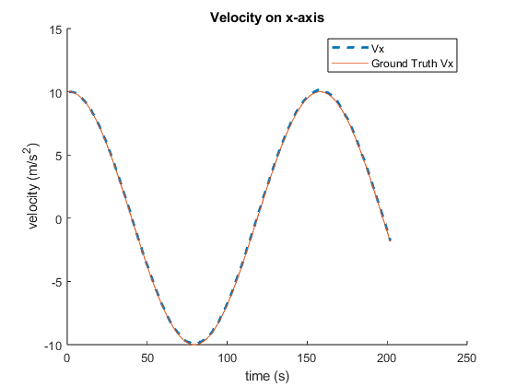
Simulation Results
Estimated velocity
Notes:
And the same can be said for the estimated velocities. Since these estimates are so close to the ground truth, it creates a bit of skepticism into our modeling of the systems noise and errors, but provides insight into the feasibility of the algorithm

Slide 29
Remaining Work
Fusion of optional additional sensor
Development in ROS Gazebo
Physical Implementation
Sphero-mini
Overhead camera for ground truth
Notes:
Now that the simulation is done, the remaining work for this thesis includes figuring out a fusion method for the incorporation of additional sensor data to provide improved accuracy in pose estimation, development of the algorithm in ROS Gazebo to allow for easily simulating the robot and transferring the program to a physical system.

Slide 30
Optional Sensor Block
Vision System
Provides position data
Minimize a cost function of squared errors
Either position or interpolated heading
Pass to 1st EKF (mobile robot)
Notes:
The incorporation of an additional sensor is made an option so that users are able to use any data that may be readily available to improve the state estimation. For our application, the current idea is to use a vision system which will provide us position information, and from there we will be able to set up a cost function of squared errors and minimize it to find our ideal sensor information. From there the improved data will be passed to the course error correction EKF with the mobile robot process model to carryout the rest of the estimation.

Slide 31
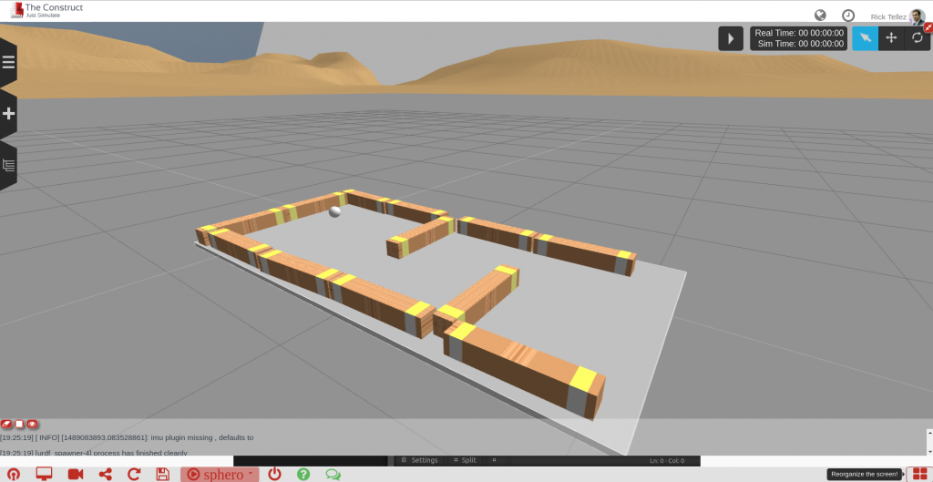
Gazebo Development
Develop algorithm without need for physical system
Easily transfer program to robot
Sphero is Gazebo Environment for Maze Navigation [13]
[13] R. Telez, “Developing ROS programs for the Sphero robot,” The Construct, Mar. 09, 2017. https://www.theconstructsim.com/developing-for-sphero/ (accessed Oct. 09, 2023).
Notes:
In parallel, I will be working on developing the algorithm in ROS’s Gazebo simulator environment. Robot Operating System, or ROS, is a common robotics middleware used to interface common hardware components with software packages. With the addition of development in Gazebo, I am able to program the robot using its native programming language and package in a simulator, allowing for quick development without having to constantly upload a program and set up the robot for testing.

Slide 32
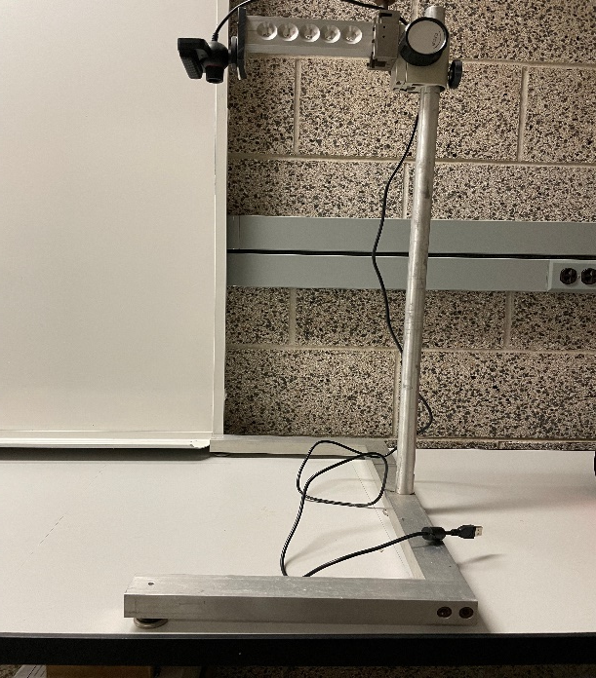

Physical implementation
Sphero-Mini
40 mm Diameter
6DOF IMU
Dual wheel drive
Sphero-Mini [14]
Vision system and workspace
[14] “Steam Education for All Ages & Stages.” STEM Kits & Robotics for Kids | Inspire STEM Education with Sphero, https://sphero.com/.
Notes:
After the ROS Gazebo development is done, the program will be uploaded to the physical system where all the debugging and tuning of noise matrices will take place. Our robot for the experiment is going to be the Sphero-Mini. It is 40mm in diameter, has a 6DOF IMU embedded inside, and has a differential drive mechanism. The workspace for the robot will comprise of an overhead vision system to collect ground truth data on the robot as well as a piece of white poster board to improve color detection for tracking of the robot.

Slide 33
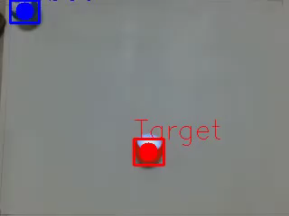
Physical Implementation
Vision-based control package created using ROS
Demonstration of Vision-Based Control Package with Sphero-Mini [15]
[15] T. Le, “sphero_ros_interaction,” GitHub, May 04, 2023. https://github.com/TaiLe2435/sphero_ros_interaction (accessed Oct. 09, 2023).
Notes:
For testing the state estimation algorithm of the robot, we will use a vision-based control package that I developed last year in ROS to provide a desired trajectory and then in parallel will be estimating its pose information using our proposed algorithm. This video here is a demonstration of two robots interacting with each other using color detection for tracking and full-state feedback for control. For our application, one robot will be removed and the remaining robot will be given commands to follow our desired path.

Slide 34
Potential Challenges
Slip in Sphero-mini
Interpolated heading error
ROS operating speed
Notes:
With the implementation of our algorithm on the physical robotic system, we have a few potential challenges we would like to address. One would be the slip inherent in spherical robots. Typical mobile robots will have wheel slip between the ground and point of contact on the wheel. A spherical robot will have slippage between the wheel and shell of the robot, as well as the shell and ground contact point causing noisy or erroneous measurements. To accommodate for this, we believe it may be necessary to change the workspace of the robot to a platform with a larger coefficient of friction so that the slip will be lessened. Currently on the posterboard, the robot is prone to slip but with slower speeds and a rougher surface, the slip should be reduced. The limit on the speed of the robot should also address the difficulties in interpolated heading error a well as the issue with ROS’s real-time operating abilities. Limiting the speed of the robot should lower the distance traveled over time, and with the distance traveled over time lessened the refresh rate need to accurately capture the robot’s data is lessened as well.

Slide 35
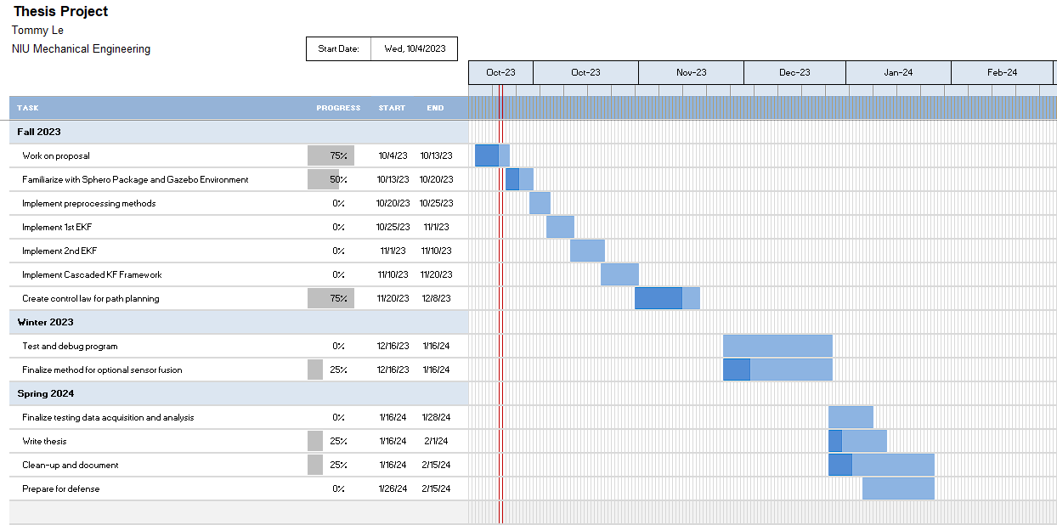
Timeline
Notes:
With all aspects of my project being addressed, here is a gantt chart showing the remaining work and timeline of my thesis. After this proposal, I will begin development of my algorithm in ROS and finish developing the path planning portion of the project. That should be done around the time winter break starts. Then during winter break, I will begin testing and debugging the algorithm on the physical system while in parallel working on implementing the method for incorporating the additional sensor data. Then come spring semester, I am expecting to finish up testing and data acquisition and analysis and begin working on documentation and my thesis defense.

